Slide 1
NP-Completeness Problems
Session 22
Henry Lucky, S.Kom. M.Kom.

Slide 2
Outline Materials
Session 22
NP-Complete problems
Vertex-cover problem
Hamiltonian cycle problem
Travelling sales-person problem
Subset-sum problem
Reduction strategies

Slide 3
Learning outcomes
22
LO 1: Explain fundamental concept of analysis algorithms
LO 2: Apply algorithm techniques and methods
LO 3: Solve a problem using specific algorithm.
LO 4: Compare several algorithm design methods

Slide 4
NP-Complete Problems
Introduction
NP-Complete problems arise in diverse domains:
Boolean logic,
Arithmetic,
Network design,
Sets and partitions,
Storage and retrieval,
Sequencing and scheduling,
Mathematical programming,
Algebra and number theory,
Games and puzzles,
Automata and language theory,
Program optimization,
Biology, chemistry, physics, and more.

Slide 5
NP-Complete Problems
Introduction
In this session we will define 4 NP-Complete problems:
Vertex-cover
Hamiltonian cycle
Travelling salesperson
Subset-sum

Slide 6
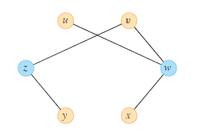
Vertex-cover
Definition
The vertex cover problem is a fundamental optimization problem in graph theory and computer science.
Given an undirected graph, it seeks to find the smallest set of vertices (nodes) that covers all the edges in the graph.
The size of a vertex cover is the number of vertices in it.
The graph beside has a vertex cover {w, z} of size 2.

Slide 7
Vertex-cover
Application
The vertex cover problem is known to be NP-hard, meaning there is no known efficient algorithm to find the optimal solution for large graphs in polynomial time. As such, it is considered one of the classic NP-complete problems. This implies that, as the graph grows larger, the time required to find the optimal solution grows exponentially.
The vertex cover problem has numerous real-world applications, including resource allocation, network design, sensor placement, and task scheduling. Its significance arises from its connection to many other NP-hard problems, making it an essential problem in the study of computational complexity and algorithm design.

Slide 8
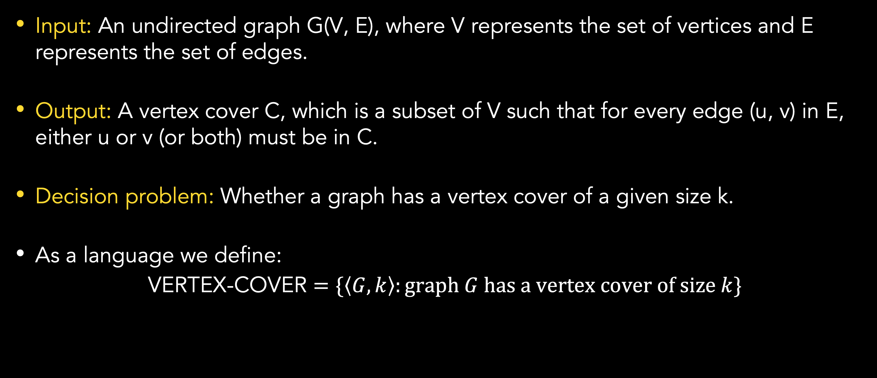
Vertex-cover
Formal definition
Input: An undirected graph G(V, E), where V represents the set of vertices and E represents the set of edges.
Output: A vertex cover C, which is a subset of V such that for every edge (u, v) in E, either u or v (or both) must be in C.
Decision problem: Whether a graph has a vertex cover of a given size k.
As a language we define:
VERTEX-COVER $=\{\left\langle G, k\right\rangle :graph G has a vertex cover of size k\}$

Slide 9
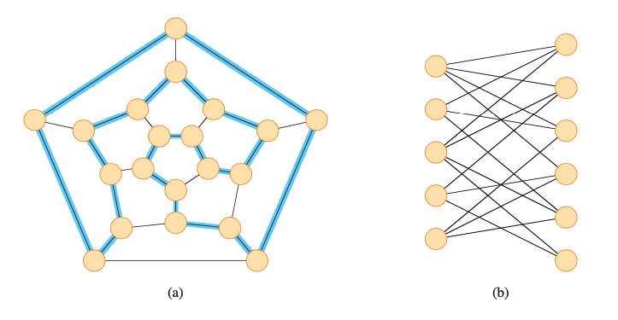
HAMILTONIAN CYCLE
Definition
The problem of finding a Hamiltonian cycle in an undirected graph has been studied for over a hundred years.
A Hamiltonian cycle of an undirected graph is a simple cycle that contains each vertex in V.
A graph that contains a Hamiltonian cycle is said to be Hamiltonian, and otherwise it is nonhamiltonian.
Beside, we have an example of Hamiltonian graph (a) and nonhamiltonian graph (b).

Slide 10
HAMILTONIAN CYCLE
Application
The vertex cover problem is known to be NP-hard, meaning there is no known efficient algorithm to find the optimal solution for large graphs in polynomial time. As such, it is considered one of the classic NP-complete problems. This implies that, as the graph grows larger, the time required to find the optimal solution grows exponentially.
The vertex cover problem has numerous real-world applications, including resource allocation, network design, sensor placement, and task scheduling. Its significance arises from its connection to many other NP-hard problems, making it an essential problem in the study of computational complexity and algorithm design.

Slide 11

Hamiltonian cycle
Formal definition
Hamiltonian Cycle
Input: undirected graph G=(V,E)
Question: Does a graph G have a Hamiltonian cycle? (Hamiltonian cycle = cycle visiting every vertex in V exactly once)
Formal language:
$$HAMCYCLE=\{\left\langle G\right\rangle :G is a hamiltonian graph\}$$

Slide 12
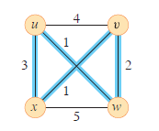
TRAVELLING SALESPERSON
Definition
The Traveling Salesperson Problem (TSP) is a well-known combinatorial optimization problem in computer science and mathematics.
It is classified as an NP-hard problem, which means there is no known efficient algorithm to solve it for all possible instances.
The goal of the TSP is to find the shortest possible route that visits a given set of cities and returns to the starting city, while visiting each city exactly once.

Slide 13
TRAVELLING SALESPERSON
Definition
As mentioned earlier, the TSP is an NP-hard problem, which means it becomes computationally infeasible to find an optimal solution as the number of cities increases.
The brute-force approach to solve the TSP involves examining all possible permutations of cities and calculating the total distance for each permutation.
However, the number of permutations grows factorially with the number of cities, making this approach impractical for large instances.

Slide 14
TRAVELLING SALESPERSON
Application
The TSP has various real-world applications, such as:
Travel planning: When a salesperson or delivery driver needs to visit multiple cities in the shortest possible way.
Circuit board manufacturing: Determining the shortest path for a robotic arm to solder components on a circuit board.
DNA sequencing: Ordering genetic fragments to find the shortest superstring.
Vehicle routing: Optimizing routes for a fleet of vehicles to minimize fuel consumption or delivery time.

Slide 15
Travelling salesperson
Formal definition
Given:
A set of cities, represented as points in a 2D plane or with specified coordinates.
The distance or cost between each pair of cities, assuming a complete graph (i.e., a direct connection exists between any pair of cities).
Objective:
Find the shortest possible tour that starts at a given city, visits all other cities exactly once, and then returns to the starting city.

Slide 16
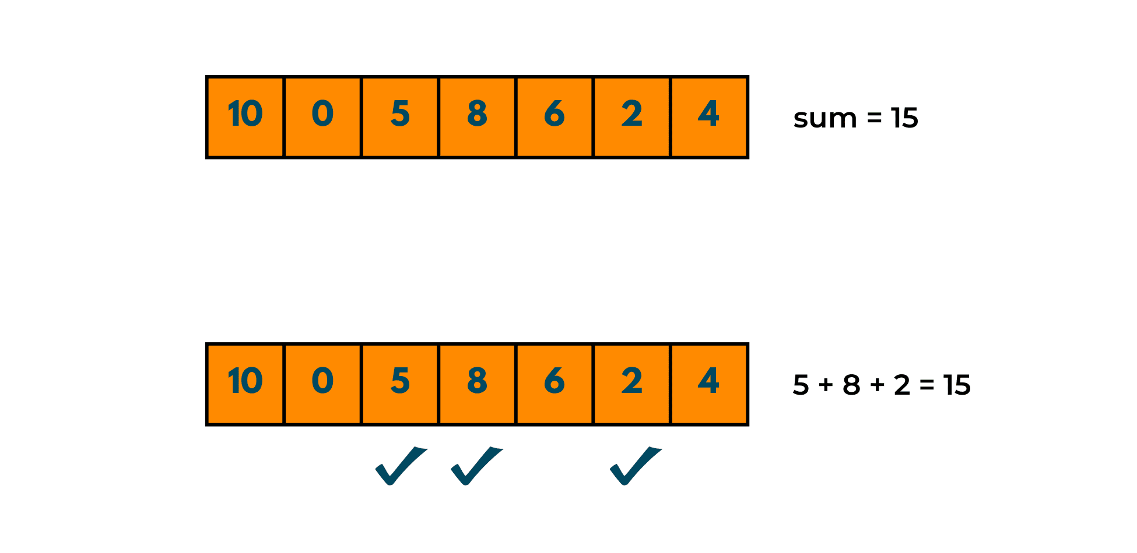
SUBSET-SUM
Definition
The subset-sum problem (SSP) is an arithmetic NP-Complete problem in computer science.
Given a finite set S of positive integers and an integer target t > 0, it ask whether there exist a subset S’ whose element sum to exactly t.
In example beside, we have S = {10, 0, 5, 8, 6, 2, 4} and t = 15, then subset S’ = {5, 8, 2} is a solution.

Slide 17
SUBSET-SUM
Application
The subset-sum problem has numerous real-world applications, including public-key system, cryptosystems, computer passwords, message verification.
The method to solve subset-sum problem could be used to solve many other problems, including:
Factoring
TSP
Any integer programming problem
The satisfiability problem
Etc.

Slide 18
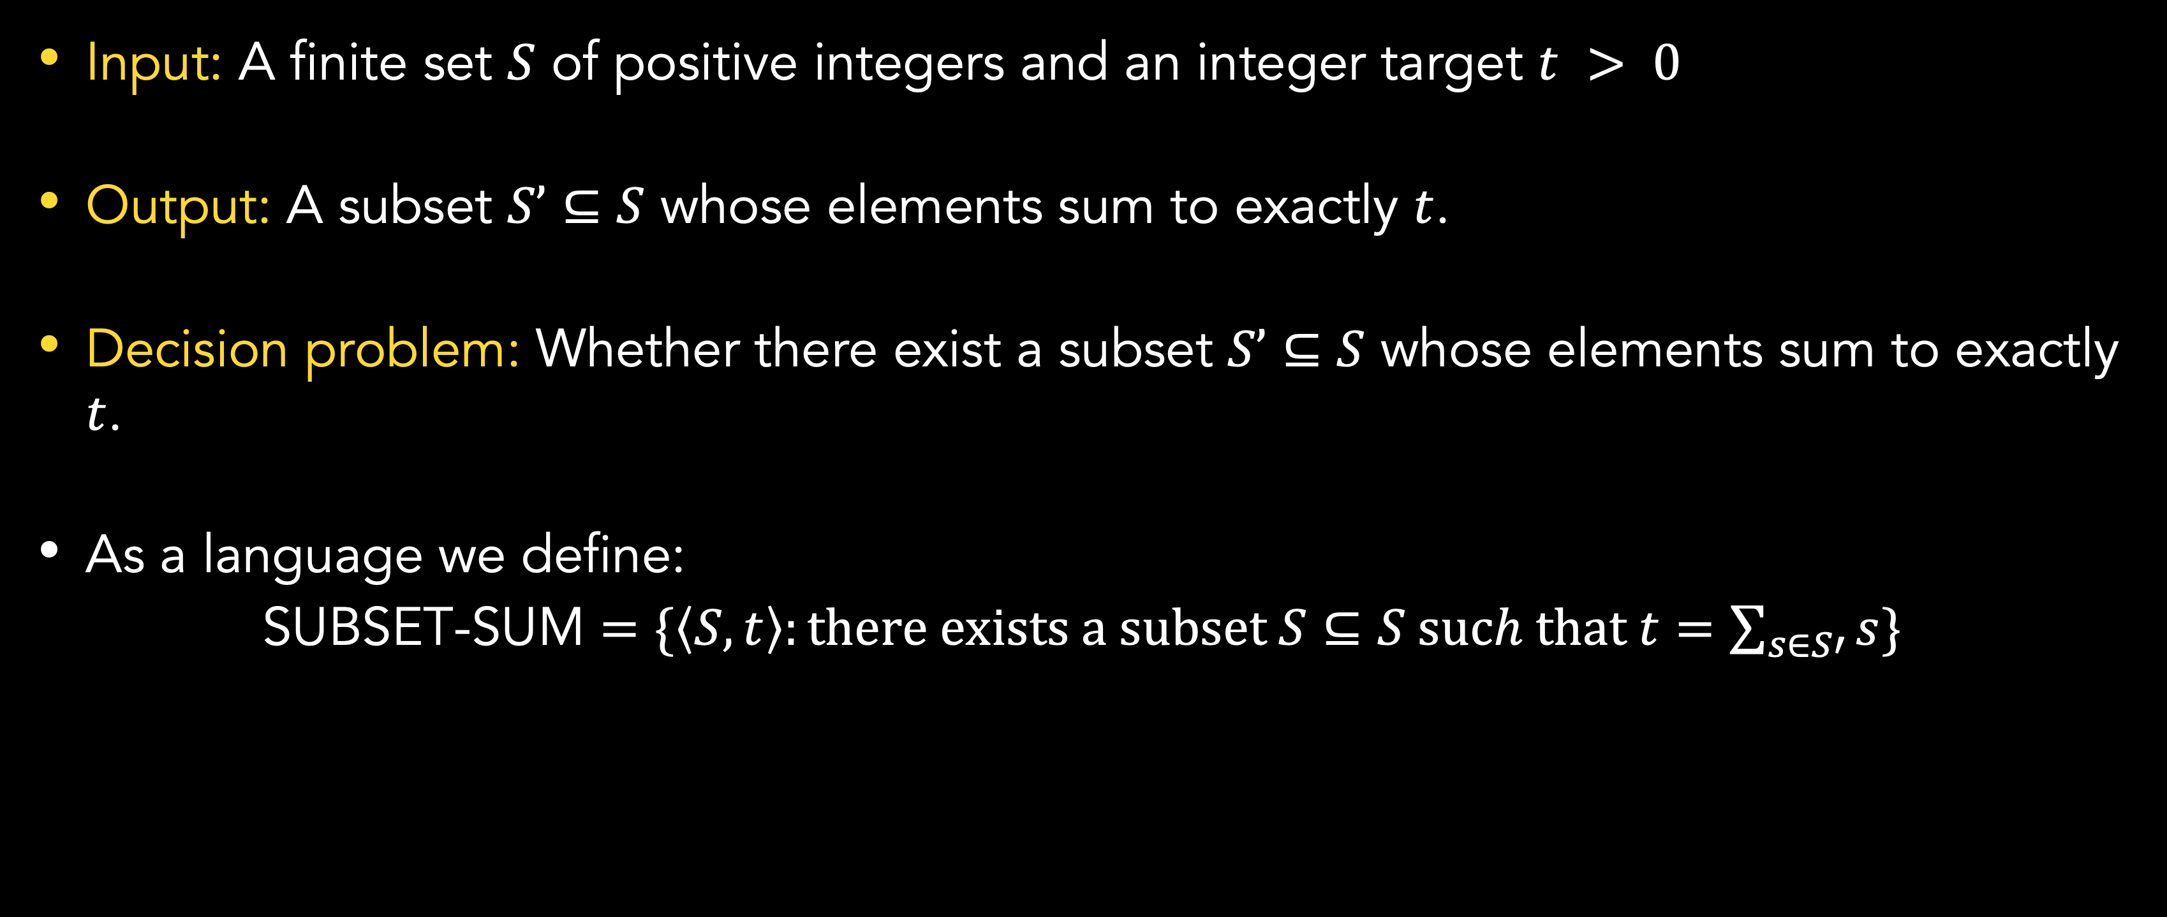
SUBSET-SUM
Formal definition
Input: A finite set $S$ of positive integers and an integer target $t > 0$
Output: A subset $S’⊆S$ whose elements sum to exactly $t$.
Decision problem: Whether there exist a subset $S’⊆S$ whose elements sum to exactly $t$.
As a language we define:
SUBSET-SUM $=\{\left\langle S, t\right\rangle :there exists a subset S⊆S such that t=\sum_{s∈S′}{s}\}$

Slide 19
Reduction Strategies
Introduction
For reduction, no single strategy applies to all NP-complete problems.
Some reductions are straightforward, such as reducing the hamiltonian-cycle problem to the traveling-salesperson problem.
Others are considerably more complicated.

Slide 20
Reduction Strategies
PITfalls
Don’t get the reduction backward.
Show that problem Y is NP-Complete by reducing a known NP-Complete problem X, so that a solution to Y gives a solution to X.
Also remember that reducing a known NP-Complete problem X to a problem Y only prove that the problem Y is NP-Hard.

Slide 21
Reduction Strategies
Go from general to specific
When reducing problem X to problem Y, you always have to start with an arbitrary input to problem X.
However, you are allowed to restrict the input to problem Y as much as you like.
For example, when reducing 3-CNF satisfiability to the subset-sum problem, the reduction has to be able to handle any 3-CNF formula as its input, but the input to the subset-sum that it produced had. A particular structure: 2n + 2k integers in the set, and each was formed in a particular way.

Slide 22
Reduction Strategies
Select an appropriate problem to reduce from
Reduce from a problem in a domain that is the same as, or at least related to, the domain of the problem that you’re trying to prove NP-complete.
For example, we can reduce from vertex-cover to Hamiltonian cycle, then Hamiltonian cycle to TSP, which all are graph problems.
However, sometimes it is better to cross from one domain to the other.
3-CNF satisfiability can be reduced to clique problem and subset-sum.

Slide 23
Summary
NP-Complete problems arise in diverse domains.
In this session, we have learned some NP-Complete problems: Vertex-cover problem, Hamiltonian cycle problem, Travelling sales-person problem, and Subset-sum problem.
For reduction, there are many strategies such as make sure to not reduce backward, and choose the appropriate algorithm.

Slide 24
References
Thomas H. Cormen. (2022). Introduction to algorithms: Fourth edition. The MIT Press. Chapter 34.

Slide 25
Thank you
NP-Completeness Problems
September, 2023

